Slide 1

Trends and Patterns in the United States for Chronic Diseases
Yesmelin, Marisol, Amanda, and Alyssa​​

Slide 2

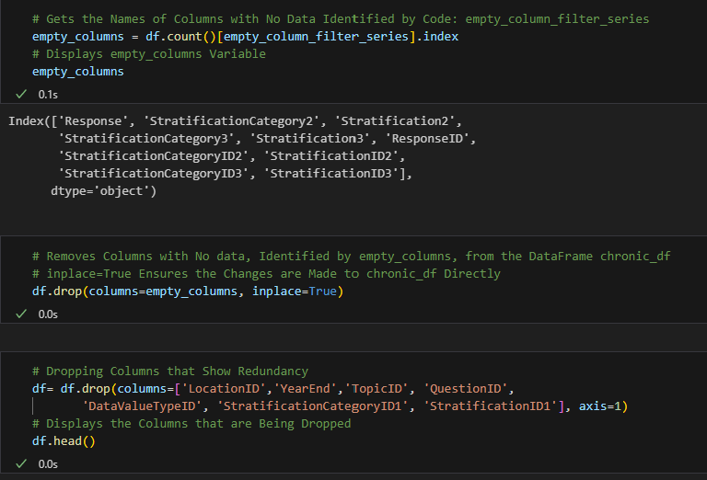
Cleaning the Data
Part 1
Exploring
Dropping
Looked at all the columns in the data set and got their names
Dropped columns that were redundant
Renaming
Creating
Renamed columns so that the DataFrame was easily readiable
Created a DataFrame with filtered data to give a basis to the start of the project, so that it can be built on

Slide 3



Cleaning Data
Renaming Columns
Getting Rid of Nan-Values and Making The Dataframe

Slide 4
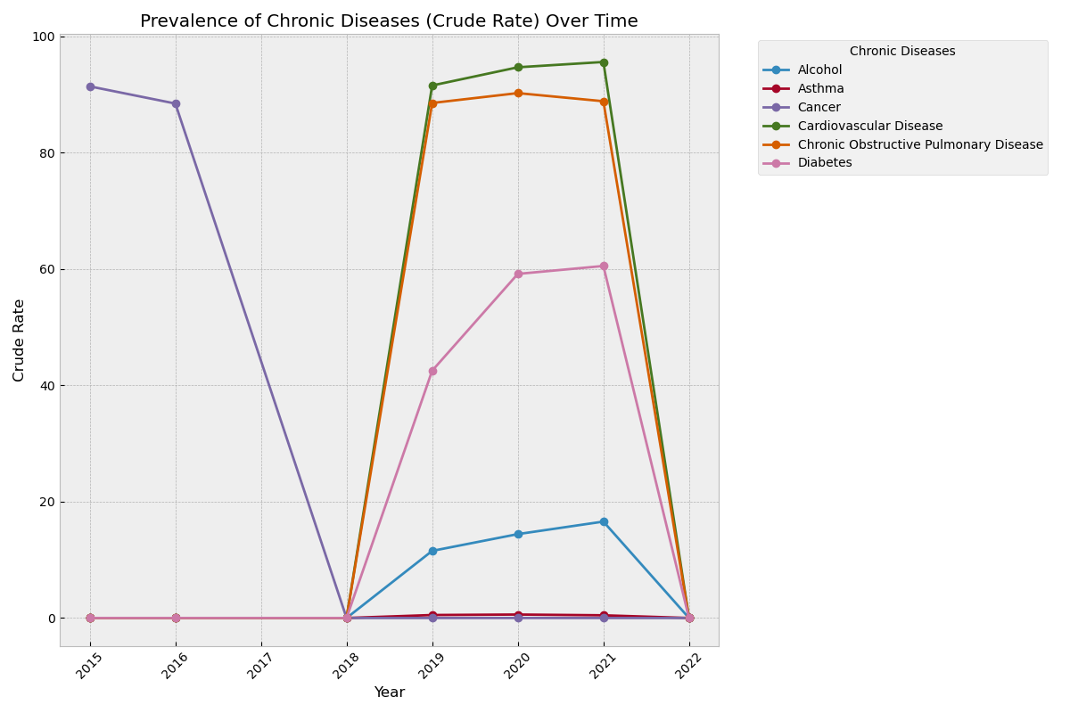
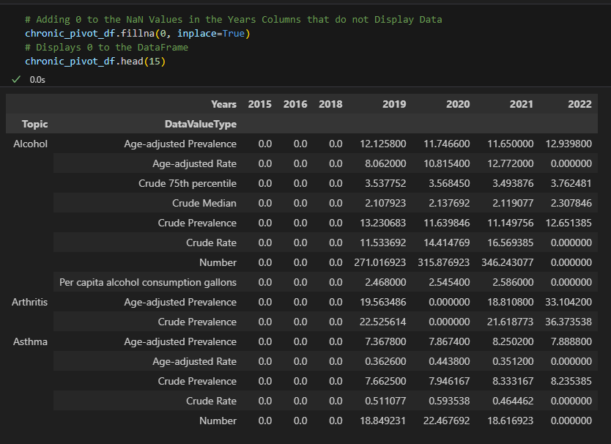
Prevalence Of Chronic Diseases and Its’ Trends
Part 2
Pivot Table
In order to get the data needed, a pivot table was created to show the years and the prevalence of each chronic disease in each respective year
What Does This Show?
Relatively stable in the beginning, but over time a noticeable increase and decrease of certain chronic diseases

Slide 5
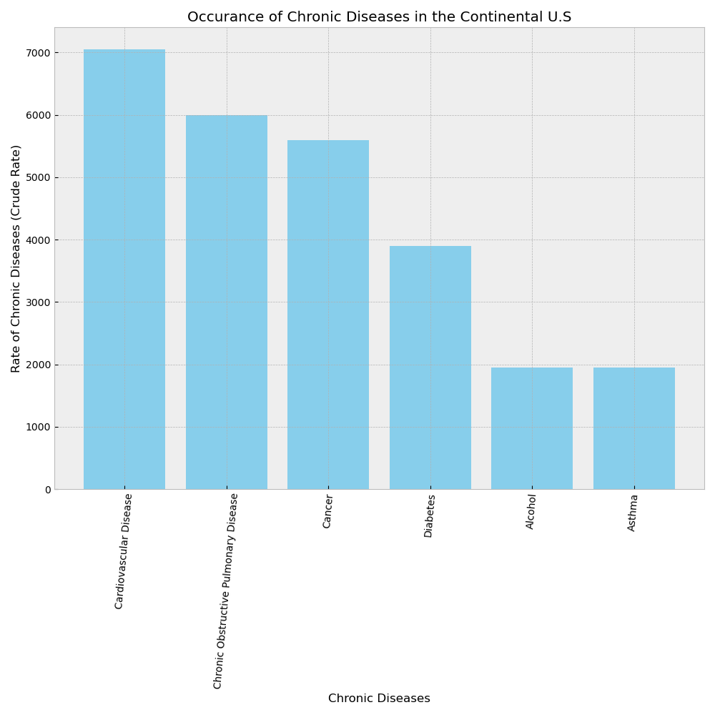
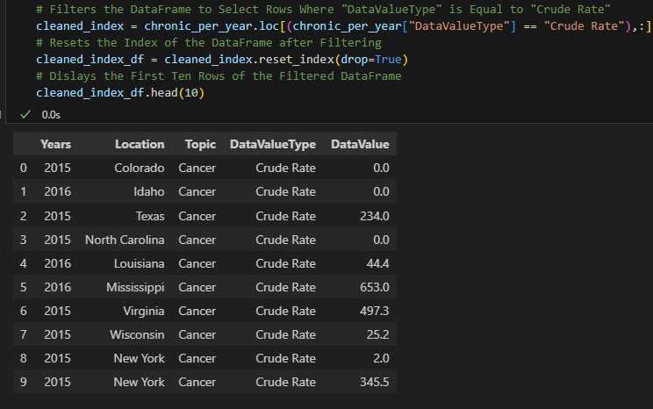
Prevalence Of Chronic Diseases
Pivot Table
In order to get the data needed, a pivot table was created to show the prevalence of each chronic disease by crude rate
What Does This Show?
The most prevalent chronic disease is cardiovascular diseases

Slide 6
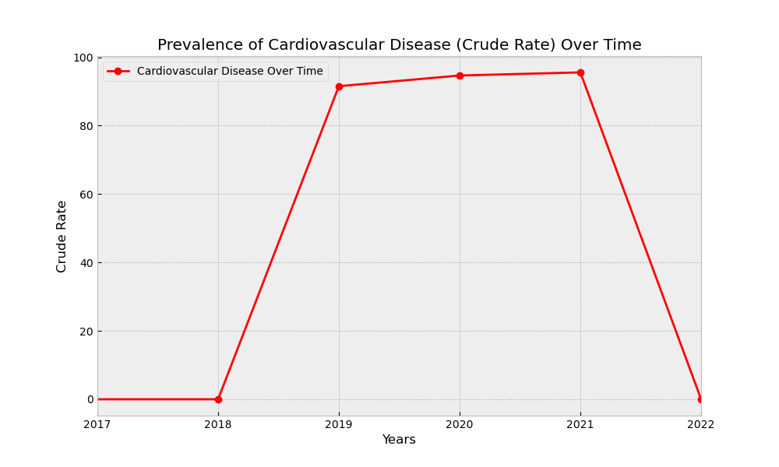
Prevalence Of Cardiovascular Disease Over Time
Part 3
What Was Done?
Based off of the previous pivot table, taking the cardiovascular data, a line graph was created to show the prevalence of it over time
What Does This Show?
It shows the 3-year study, between 2019-2021, of cardiovascular disease
What Is Not being Shown?
The data before 2019 was not shown, as it was not collected, making it not valuable to this visualization

Slide 7

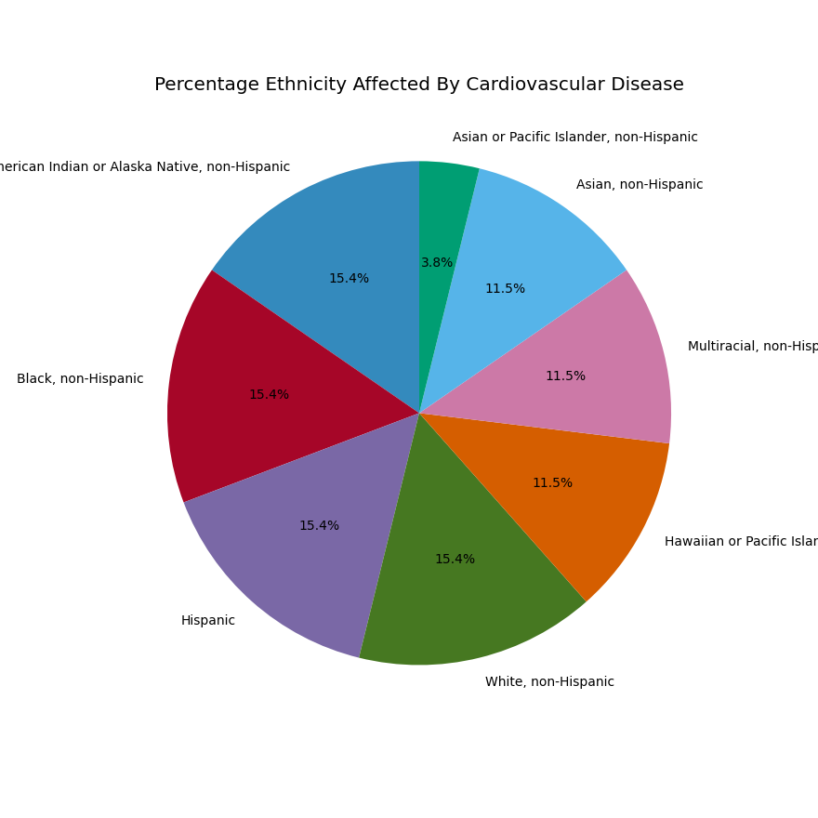
Race/Ethnicity Affected By Cardiovascular Disease
What Was Done?
The data was filtered to only show cardiovascular diseases in relation to race/ethnicity
What Does This Show?
Asian or Pacific Islander, non-Hispanic had the lowest percentage of cardiovascular diseases
What Is Going On?
Due to verified data being cleaned prior, it provided even data across the board for races/ethnicities that have a bigger population

Slide 8
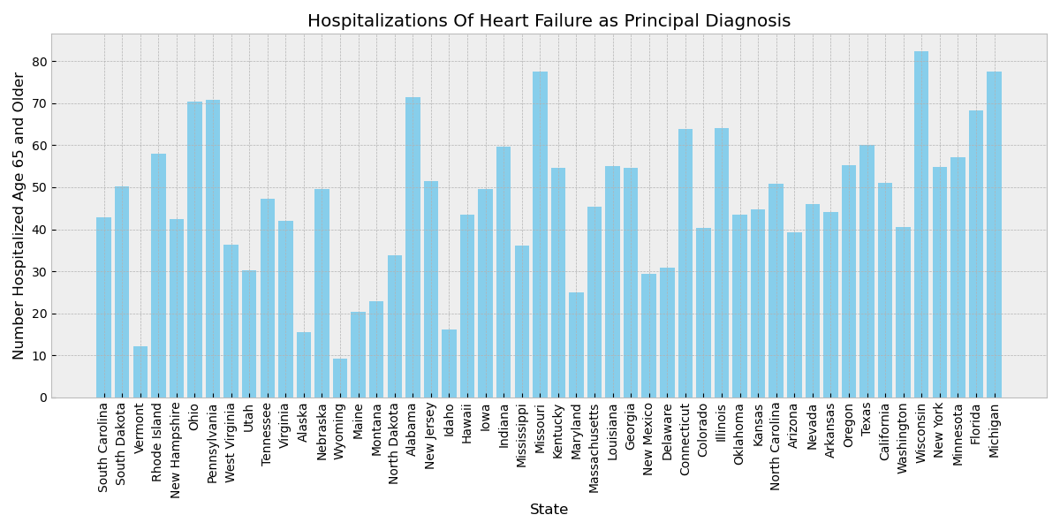
Hospitalizations of Hearth Failure (65 Years+)
What Was Done?
DataFrame was created to show per state, how many people, aged 65 years and older, were hospitalized due to cardiovascular diseases
What Does This Show?
There is generally decent distribution amongst all states, with Wisconsin being the highest and Wyoming being the lowest

Slide 9
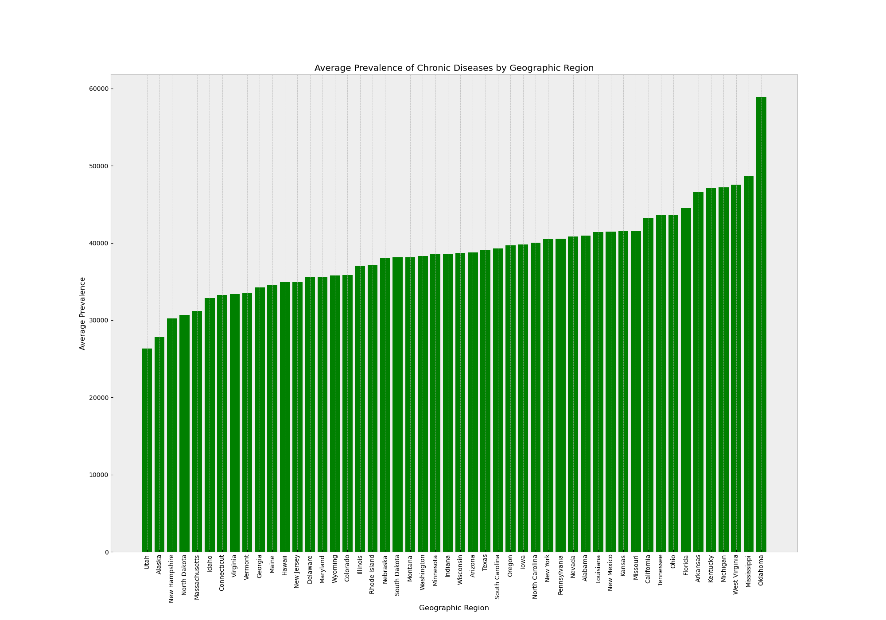
Average Prevalence of Chronic Diseases by Geographic Region
Part 4
What Was Done?
Based off of the us_chronic_cruderate_df, a .sum function was used to determine average prevalence of chronic diseases
What Does This Show?
Shows that Oklahoma had the highest average prevalence of chronic diseases, while Utah has the lowest

Slide 10
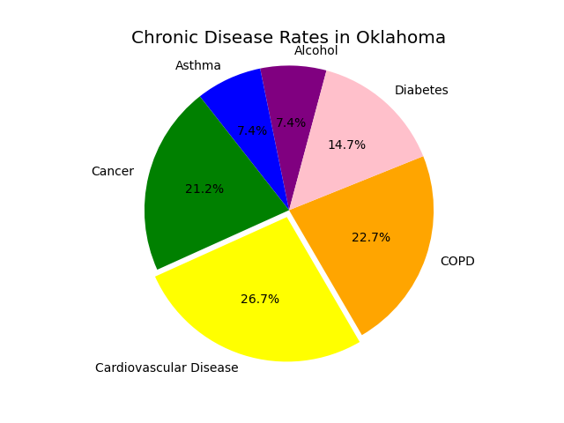

Chronic Disease Rates in Oklahoma
What Was Done?
Based off of the previous data, using Oklahoma, determined the rates of the chronic diseases in that state alone
What Does This Show?
Cardiovascular disease is the highest chronic disease in Oklahoma, with the lowest being both asthma and alcohol

Slide 11
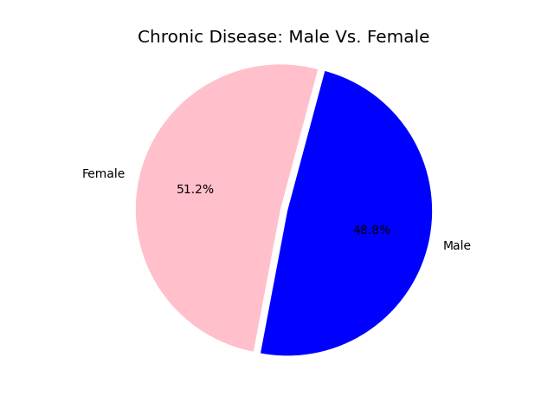
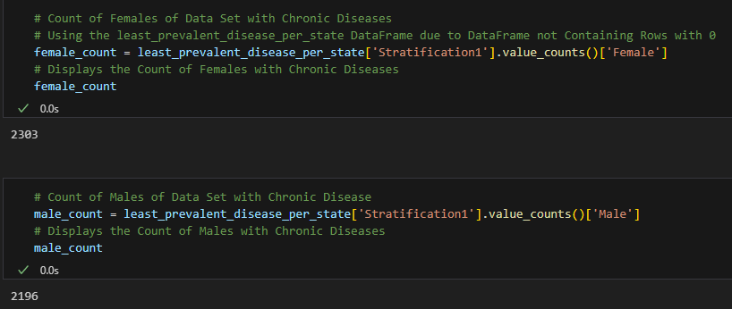
Chronic Disease Prevalence: Male Vs. Female
Part 5
What Was Done?
Using the DataFrame listed below, the overall count of males and females with chronic disease was produced
What Does This Show?
Females, overall, have a slightly higher rate of chronic diseases than males

Slide 12
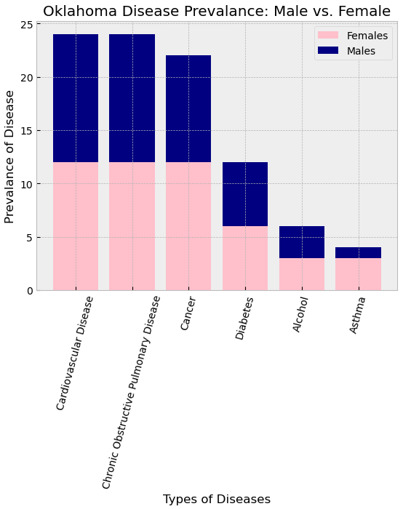
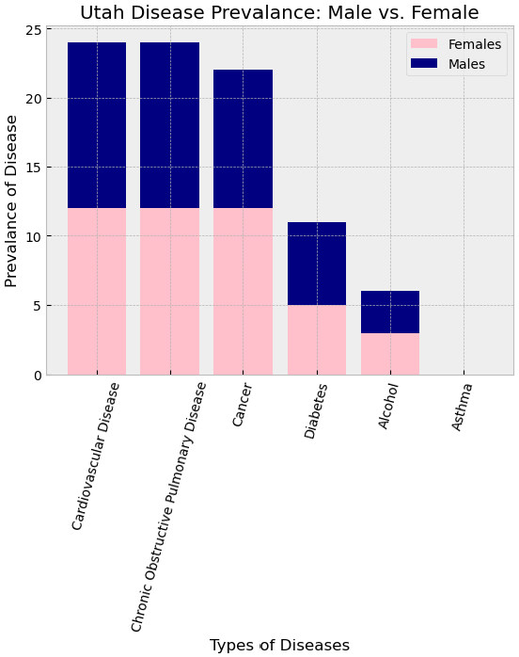
Chronic Disease Prevalence: Oklahoma Vs. Utah
What Was Done?
Using the male_female_df to find the count for each state, per gender, and per chronic disease category, and put it into a stacked bar graph
What Does This Show?
This shows an almost identical graph between Oklahoma and Utah, with the exception being a slight difference in the diabetes column and there being no data recorded for asthma in Utah
Why is this Happening?
Due to the process of the verified data being cleaned prior to the filtering done for this project, the data was placed identical to one another

Slide 13
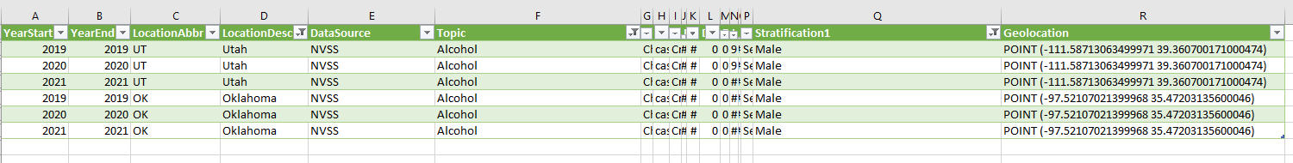
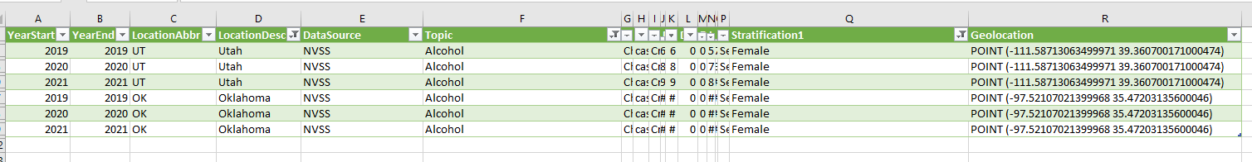
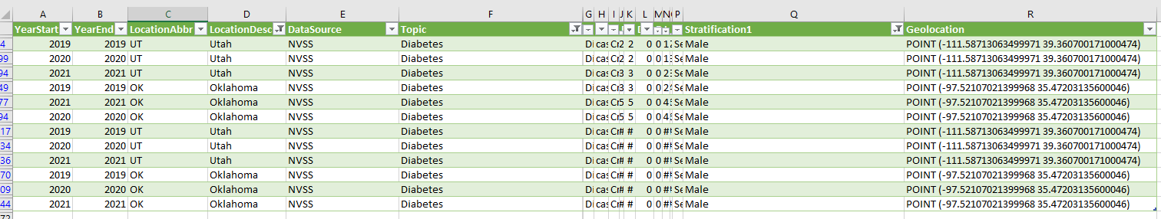
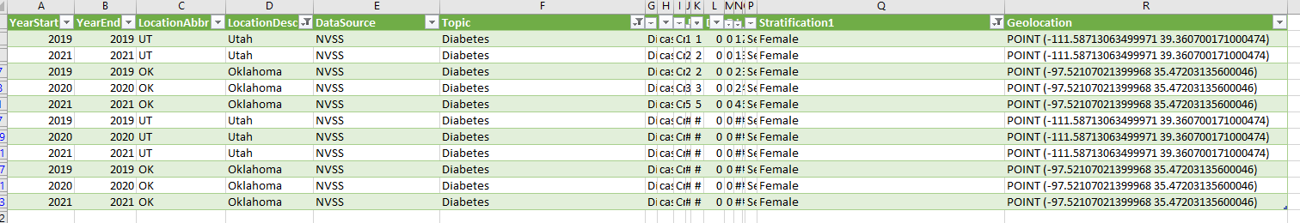

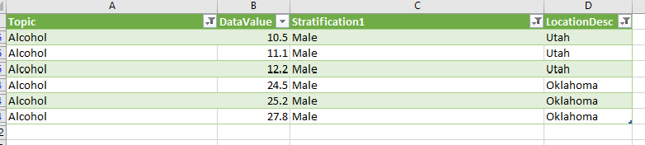

Verification of Data
How it Was Verified?
Checking the two DataFrames used, it showed identical data to each other. The least_prevalent_disease_per_state contained all of the data that previous data sets consisted of
All data and visualizations matched each other off of the data sets. The data is verified for this project, however the cleaning process prior to starting the project, created the matching data

Slide 14

In Conclusion
Large portion of the population face a high risk of developing a chronic cardiovascular disease
Data does show a downward trend on chronic diseases across the board
This downward trend could be inferred due to medical advancements over the past few years

